Slide 1
02 Household Power Consumption
Graduation Project

Slide 2
Project Definition
Using Linear regression to monitor overall household electrical energy consumption in kilowatts per minute.

Slide 3
Linear Regression
A machine learning algorithm based on supervised learning. It performs a regression task. Regression models a target prediction value based on independent variables. It is mostly used for finding out the relationship between variables and forecasting.

Slide 4

What is Scikit-Learn (Sklearn)
Scikit-learn (Sklearn) is the most useful and robust library for machine learning in Python. It provides a selection of efficient tools for machine learning and statistical modeling including classification, regression, clustering and dimensionality reduction via a consistence interface in Python. This library, which is largely written in Python.

Slide 5
We tried to find the best predictor values by using two methods:
Main Difference Between Active and Reactive Power.
Prediction the Global Active Power as values of y.

Slide 6
Main Difference Between Active and Reactive Power
The main difference between active and reactive power is that Active Power is actual or real power which is used in the circuit while Reactive power bounce back and forth between load and source which is theoretically useless.

Slide 7
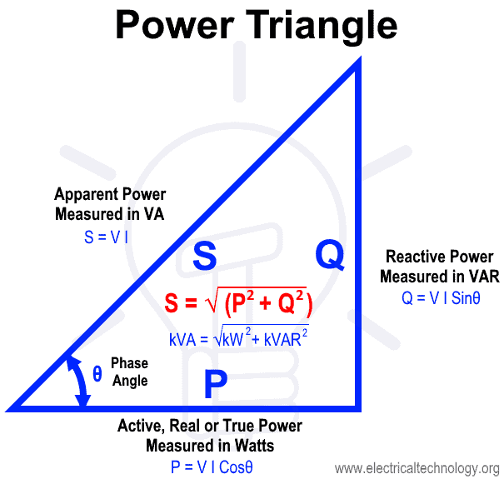

Slide 8
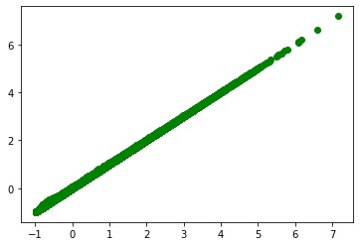
Chart for General power with power consumption
Before prediction

Slide 9
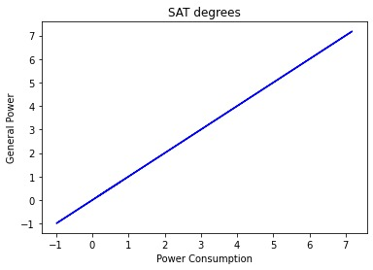
Chart for General power with power consumption
prediction without X & Y

Slide 10
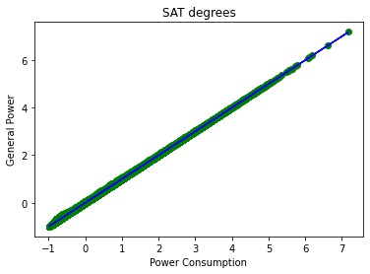
Chart for General power with power consumption
final result

Slide 11
Prediction the Global Active Power as values of y.
The other theory is to take the values of Global Active Power to be the value of the y-value, which are the values that are the prediction values, and the other values will be the X- values, so the model will deduce the Global Active Power using polynomial features.

Slide 12
Polynomial features:
Polynomial features are those features created by raising existing features to an exponent.
For example, if a dataset had one input feature X, then a polynomial feature would be the addition of a new feature (column) where values were calculated by squaring the values in X, e.g. X^2. This process can be repeated for each input variable in the dataset, creating a transformed version of each.

Slide 13
As such, polynomial features are a type of feature engineering, e.g. the creation of new input features based on the existing features.
The “degree” of the polynomial is used to control the number of features added, e.g. a degree of 3 will add two new variables for each input variable. Typically a small degree is used such as 2 or 3.

Slide 15
Thanks For Listening

